Slide 1
Object Recognition to keep Social Distancing Norms in check
Under the guidance of Prof. Dr. Samit Biswas
Submitted by-
Abhinaba Chowdhury (510519007)
Abhiroop Mukherjee (510510109)
Debarghya Dey (510519087)
Jyotiprakash Roy (510519016)
Shrutanten (510519048)
(3rd Semester, Academic Year 2020-21)
IIEST, Shibpur

Slide 2
Categorization :
The entire range of activities of this semester has been divided into two categories :
Knowledge Refinement - Image handling/processing techniques.
Social distancing checker.

Slide 3
Image handling/processing techniques :
Basic concept of reading/writing an image file.
Histogram for a Gray level image.
Histogram equalization for Contrast enhancement.
Reducing salt-and-pepper noise.
Mean, Median and Mode filters.
Local Thresholding
Global using Otsu’s thresholding algorithm.
Adaptive thresholding.
In all of the above cases, we have implemented our own functions in Python and whenever possible cross-verified them with standard library functions of OpenCV or Pillow.

Slide 4
Image handling/processing techniques (contd.) :
1. Histogram 2. Contrast Enhancement using Histogram Equalization
(a) Grayscale Image
(a) Original Image
(b) Implemented function (c) Library function hist()
(b) Edited Image

Slide 5
Image handling/processing techniques (contd.) :
3.
4.
(a) Original Picture (b) Mean Filter
(a) Original Photo
(b)Edited Image - Salt And Pepper Noise Removal
(c) Median Filter (d) Mode Filter

Slide 6
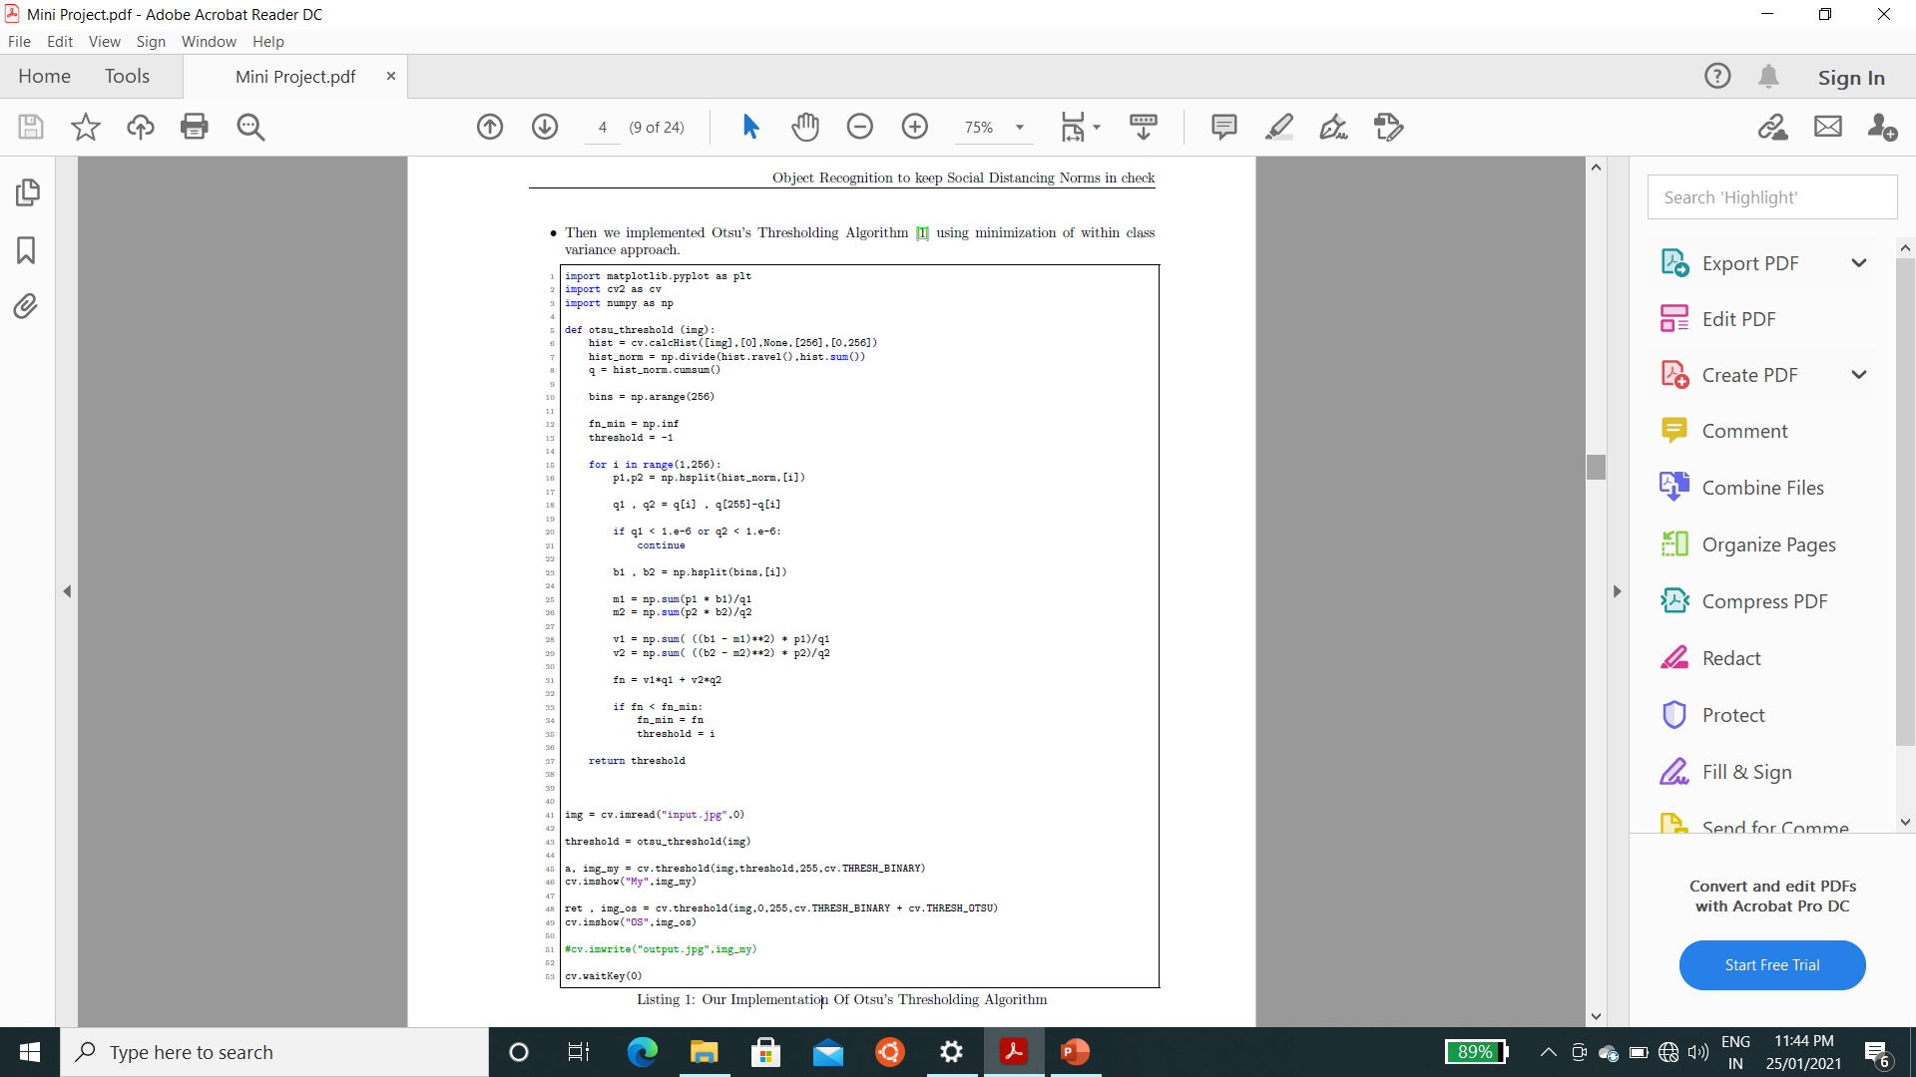
Image handling/processing techniques (contd.) :
5.
Our Implementation Of Otsu's Thresholding Algorithm

Slide 7
Social distancing checker – Introduction :
With the increase in the spread of the dangerous and highly contagious Novel Coronavirus and the underlying disease caused by it, COVID-19, it is a requirement now more than ever to follow the social distancing norms set in place by the scientists and researchers.
But as we all know, India is a country with a not-so-small population, so it is pretty understandable and obvious that the law enforcement will not be able to actually enforce it on every single person. Therefore, new means of automata in place of actual individuals is a no brainier.
That is where we come in.
The idea behind the working of this software was simple. The software just needed to be able to look at a live feed (or recorded footage) of a camera and know which of the people present in the footage are actually following the social distancing norms and which of them are not, and mark either one appropriately. That is where our journey to build a social distancing checker started.

Slide 8
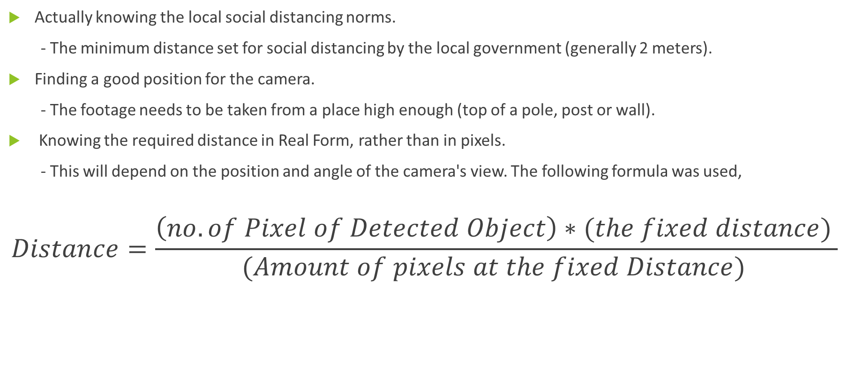
Social distancing checker – Basic requirements :
Actually knowing the local social distancing norms.
- The minimum distance set for social distancing by the local government (generally 2 meters).
Finding a good position for the camera.
- The footage needs to be taken from a place high enough (top of a pole, post or wall).
Knowing the required distance in Real Form, rather than in pixels.
- This will depend on the position and angle of the camera's view. The following formula was used,
$$Distance=\frac{\left(no. of Pixel of Detected Object\right)∗(the fixed distance) }{(Amount of pixels at the fixed Distance) }$$

Slide 9
Social distancing checker – Tools used :
Software Requirements
Python - 3.5 or above
PyCharm IDE
OpenCV-Python - version 2 or above
YOLOv3 Configuration and Network Weights
NumPy
Hardware Requirements
A GPU is optional yet recommended to get the best performance
If a GPU is not being used, the CPU need to be good enough
NOTE : Due to lack of hardware resources, we decided on shifting to Google Colab. Google Colab is an online iPython development environment similar to Jupyter Note-book, to speed up processes.

Slide 10
Social distancing checker – Blueprint :
Video Input
Processing
Detecting people
Measuring distance between every pair of people
Mark the ones violating social distancing norms

Slide 11
Social distancing checker – Video input :
Owing to restrictions due to COVID-19, real time videos could not be recorded. Also, it was tough to get our hands on the footage of a security camera. Instead, pre-recorded videos of crowdy places like streets, shops etc. from the internet have been used.
Pedestrian Video (b) Shibuya Video
Still images from the pre-recorded videos

Slide 12
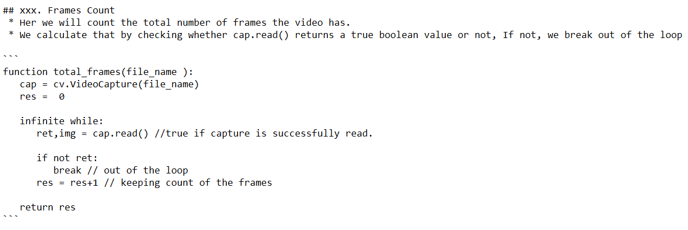
Social distancing checker – Processing :
We used the OpenCV library for our video/image processing.
A Sample Code to count no. of frames in a video :

Slide 13
Social distancing checker – Detecting people :
Algorithm used – YOLO (“You Only Look Once").
It is an algorithm based on regression, which trades a bit of accuracy for large improvements in speed. Instead of selecting interesting parts of an image, it predicts classes and bounding boxes for the whole image in one run of the algorithm.
Implementation used - Darknet ,which was written in the C Language and uses CUDA (Compute Unified Device Architecture) technology, making it really fast and provides for making computations on a GPU, which is essential for real-time predictions.
The Darknet YOLO model that we used here is pre-trained on the COCO (Common Objects in Context) dataset. We did not train the object detection neural network model ourselves due to the lack of time.
Working of YOLO : Ultimate aim is to predict a class of an object and the bounding box specifying object location.
c = Value corresponding to the class of an object
p_{c} = The probability that there is an object bounding the box

Slide 14
Social distancing checker – Detecting people (contd.) :
The image is split into cells(19 x 19 grid). Each cell is responsible for predicting 5 bounding boxes (in case there are multiple objects in this cell). Therefore, we arrive at
a large number of 1805 bounding boxes for one image.
Most of these cells and bounding boxes will not contain an object. Therefore, the value p_{c} is
predicted, which serves to remove boxes with low object probability and bounding boxes with the
highest shared area in a process called non-maxima suppression.

Slide 15
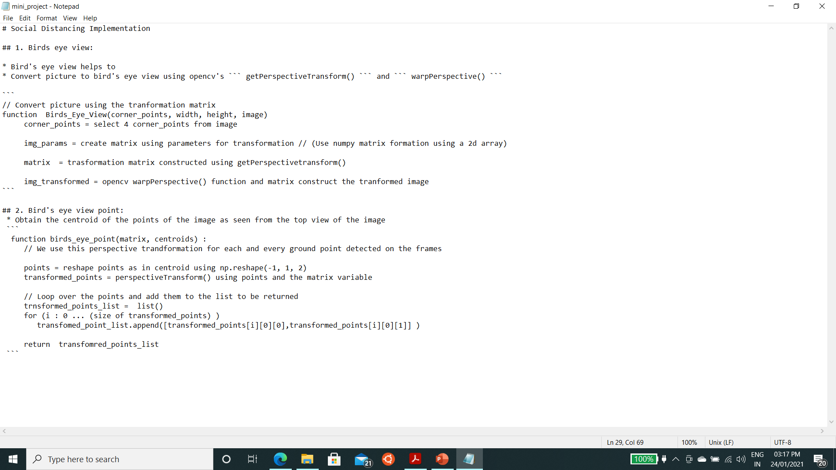
Social distancing checker – Measuring distance between every pair of people :
Directly measuring the Euclidean distance between the centroids of every two detections is not a proper method due to the position of the camera and the viewing angle. The solution is Bird’s Eye View which is done by conversion of the 3-dimensional footage to 2-dimensions.
This was done in two steps. At first a function was implemented to get the transformation matrix for the Bird’s Eye View . Then a second function uses the above output to get the corresponding points in the image.
Pseudo-Code :

Slide 16
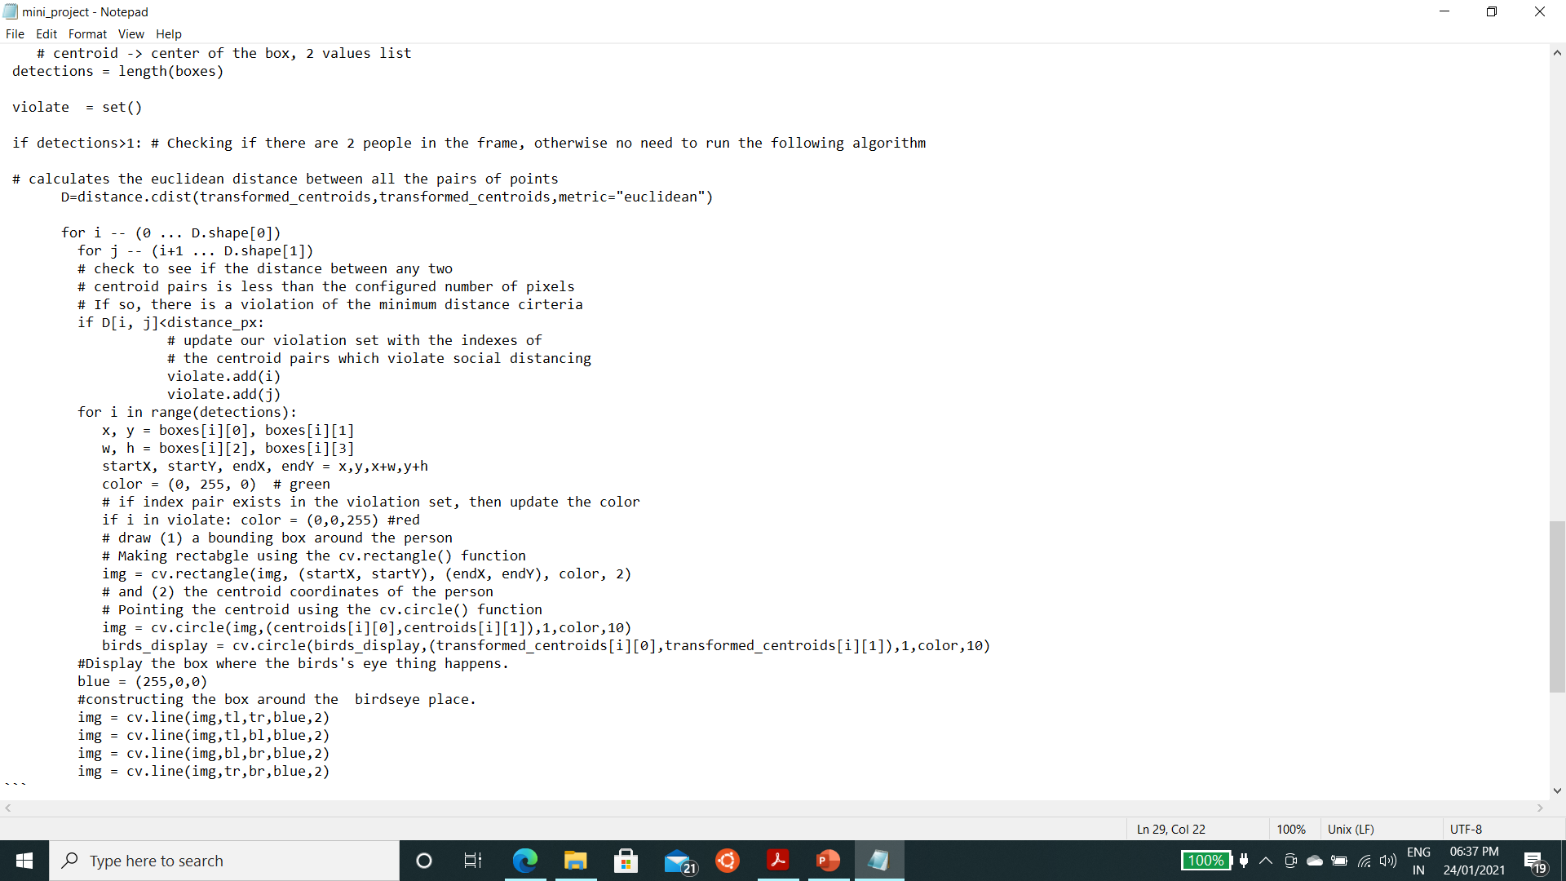
Social distancing checker – Mark the violations :
We just needed the coordinates of the people in the violation zone.
Their detection rectangle is turned red as opposed to green.
Pseudo – Code :

Slide 17
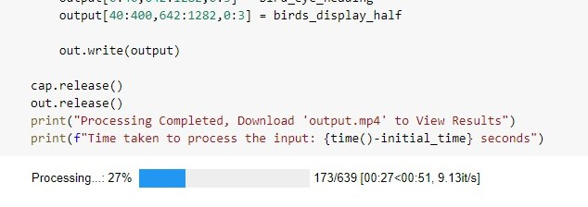
End Result
We were able to achieve avg. 8fps processing in Google Colab (low 8’s and high 9’s) and were able to detect people with their detected probability at least 0.9 (Object detected is 90% person)

Slide 18
Social distancing checker – Shortcomings :
Camera position - The camera that will record the feed needs to be placed at a position high enough. Horizontal position is a complete no. For minimum error, camera should be perpendicular to ground which is not always possible.
Enormous computing power - It is not ideal to use this checker on a live feed because even for recorded footage, we were not able to get more than 5-7 frames per second with a decent GPU.
The minimum social distance in pixels - It is not easy to calculate any distance in pixels since a small change in viewing angle can bring a large change in the distance measurements.
Over populated areas – As YOLO sacrifices accuracy for speed, it really struggles with multiple objects in a single cell.
An Example Photo Of YOLO Object Detection Failing.
The Big Red Box should not show as output

Slide 19
Social distancing checker – Solutions :
A few of the limitations can be solved by adopting the following means:
1. Recording via a drone can completely eliminate the viewing angle problem, since a drone can be
stabilized at exactly 90 degrees to the ground. In a room, hall or enclosed area, a camera at the centre of
the ceiling will work wonders.
2. The checker can work in densely populated areas as well if we use RCNN or any classification
based algorithm. But that will further slow down the checker since RCNN is a much slower
algorithm than YOLO.

Slide 20
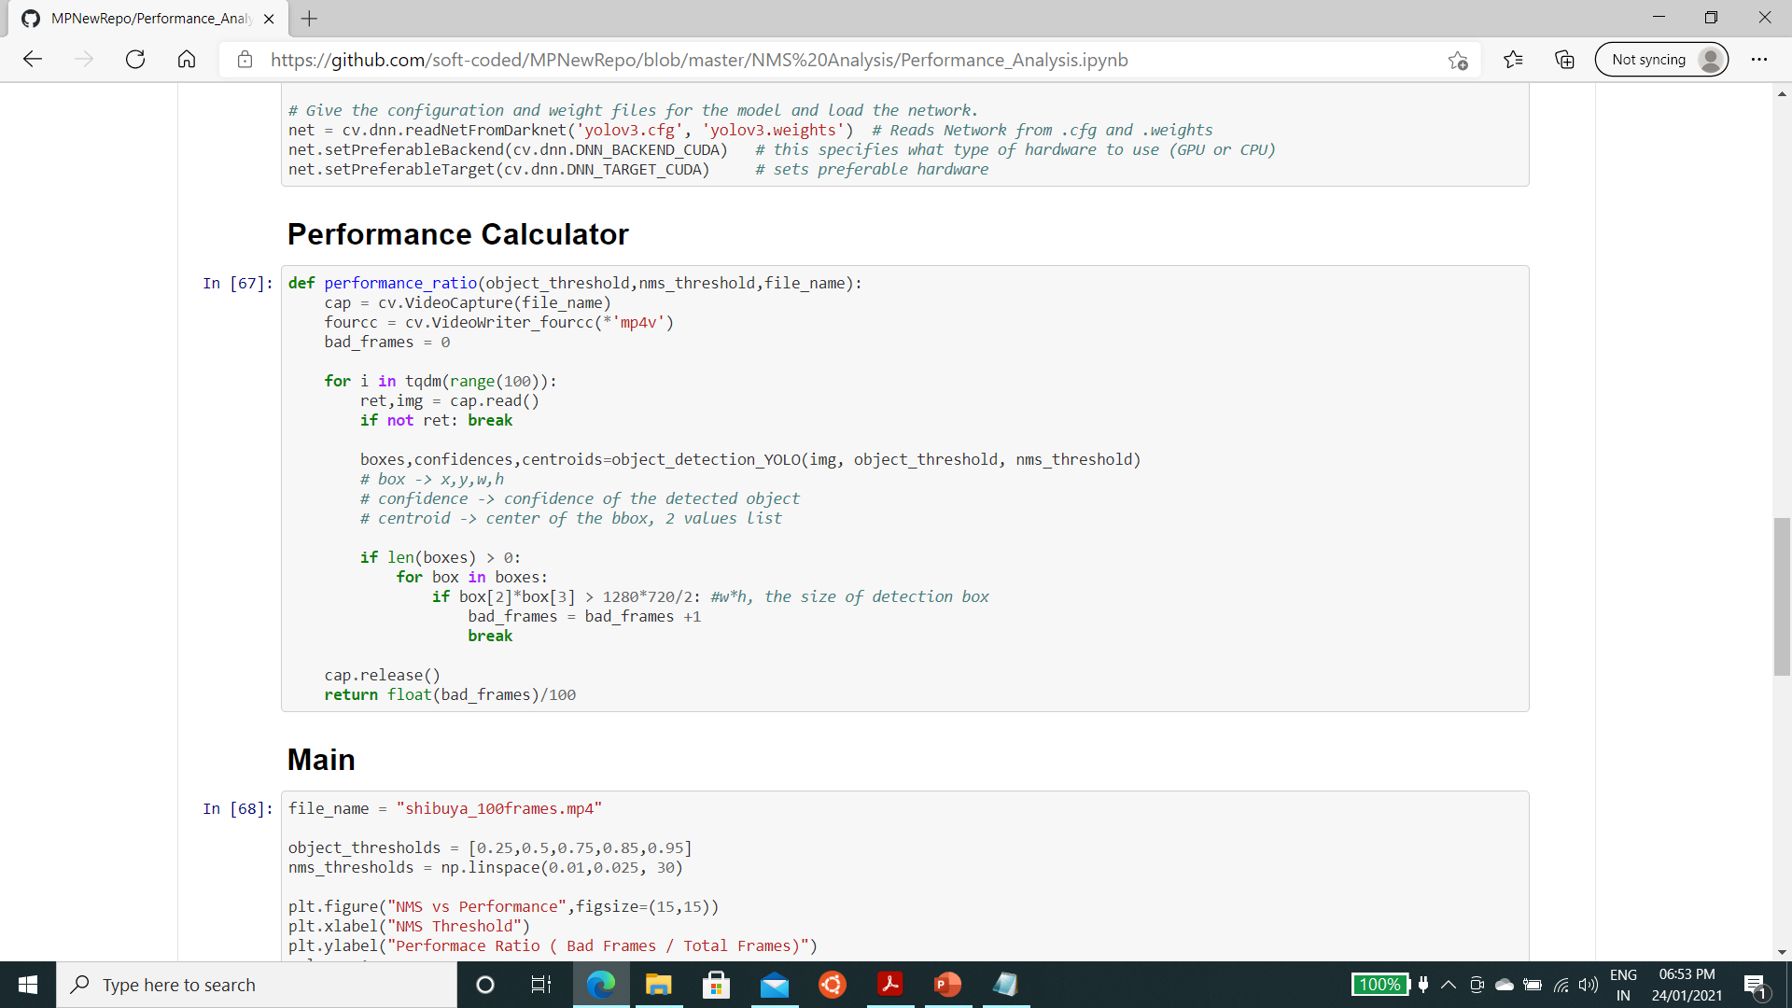
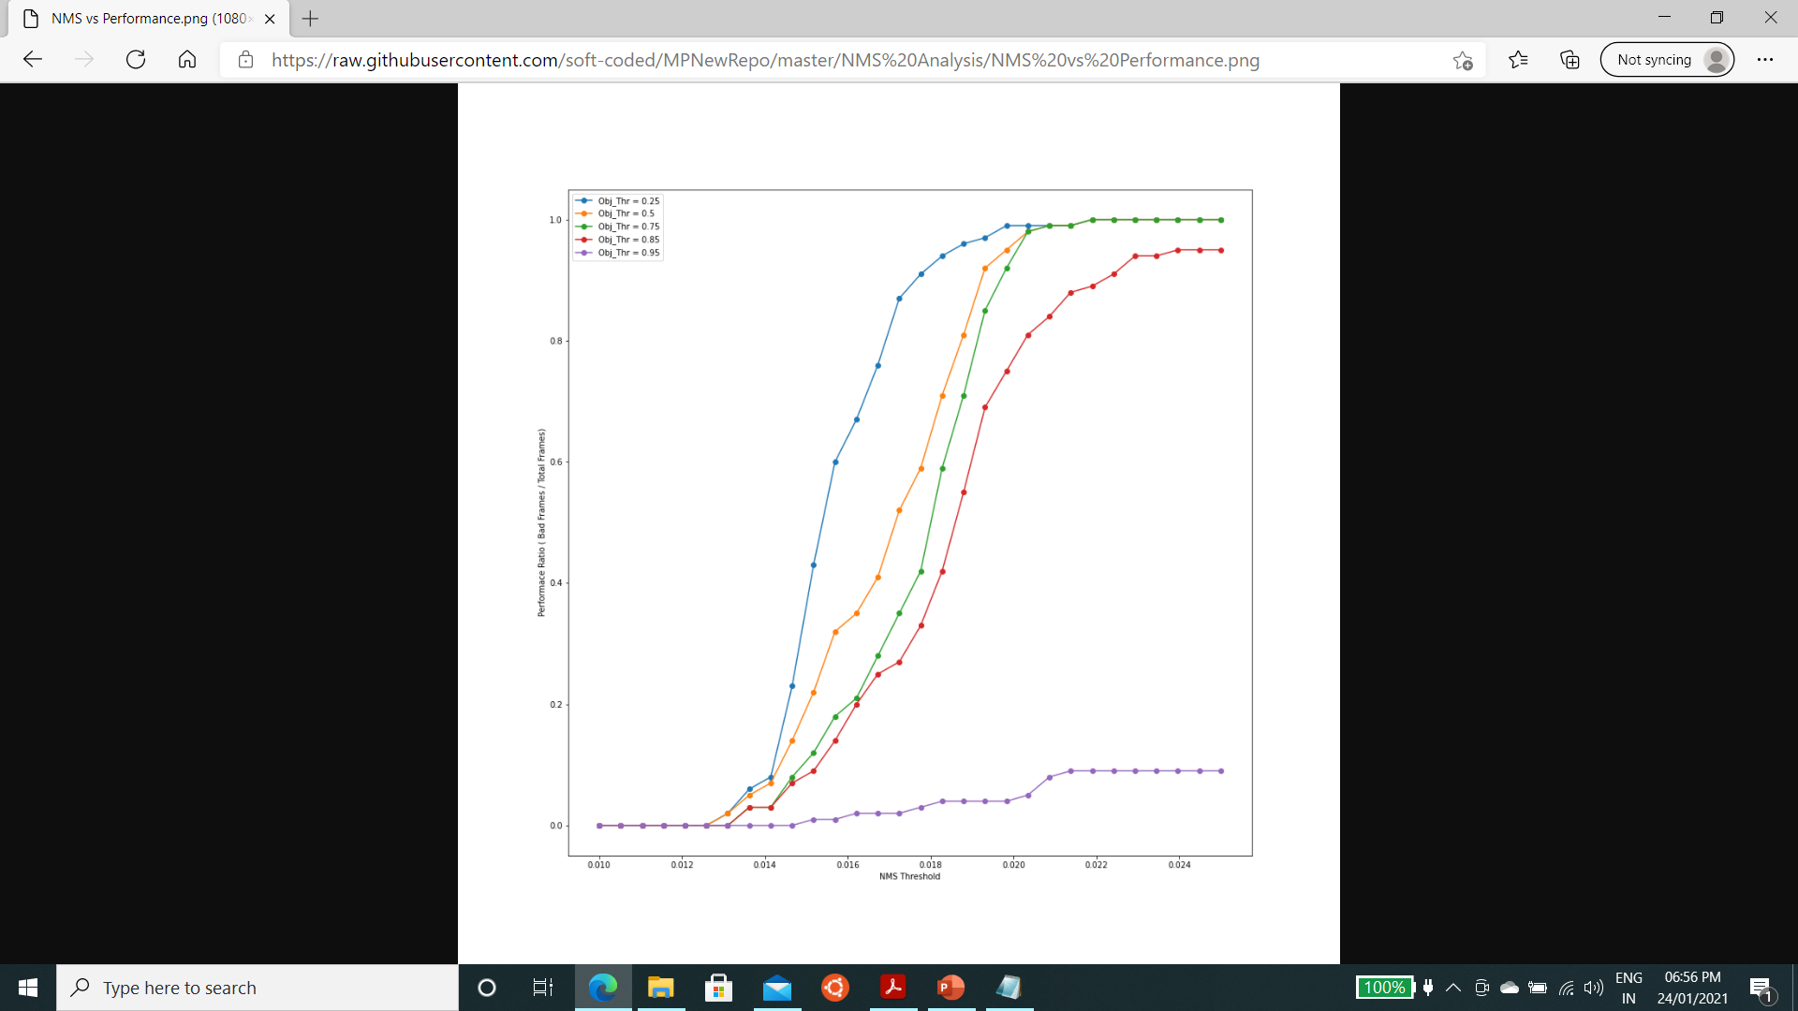
Social distancing checker – NMS Analysis :
Graph of Performance ratio vs NMS Threshold :
Code for performance calculator :

Slide 21
Social distancing checker – NMS Analysis Inference:
Graph of Performance ratio vs NMS Threshold :
From the graph, we can safely take Object Threshold 0.85 and NMS threshold 0.013
This Observation is Video Dependant, so this analysis must be done for every new camera angle, increasing first time setup costs.

Slide 22
Social distancing checker – Improvements to be made :
Although this application does serve well as a starting point for an automated
social distance checker, following are the ways in which we can improve the checker:
1. We can make the entire thing command line based so that an average consumer will not have
to dig around the code to calibrate the algorithm to his or her needs.
2. One Inherent Problem with our Pre-Trained Model is the Class Variance. We are using the pre-trained model to detect people only, whereas the model is also computing to detect other 79 objects. We can save up computing time by training our yolov3 model from scratch to detect people only.
3. We can add a help panel for first time users.

Slide 23
Social distancing checker – Important links :
Actual code :
MPNewRepo/Mini_Project.ipynb at master · soft-coded/MPNewRepo · GitHub
Input and Output :
MPNewRepo/Input-Output at master · soft-coded/MPNewRepo · GitHub

Slide 24
Bibliography :
References :
[1] N. Otsu, “A threshold selection method from gray-level histograms," IEEE Transactions on Systems, Man, and Cybernetics, vol. 9, no. 1, pp. 62{66, 1979.
[2] D. Kriegman, “Homography estimation," Lecture computer vision I, CSE a, vol. 252, 2007.
[3] J. Redmon, S. Divvala, R. Girshick, and A. Farhadi, \You only look once: Unified, real-time object
detection," 2016.
[4] J. Redmon and A. Farhadi, “Yolov3: An incremental improvement," 2018.
[5] “Yolo algorithm and yolo object detection: An introduction - appsilon: End to end data science
solutions," Oct 2020.
THE END

